Slide 1
UX RESEARCH METHODS: A CASE STUDY OF A FINTECH MOBILE APP
Coursework, 3rd year - Human-Computer Interaction / UX Design
Student name
University placeholder
2026

Slide 2
Why UX research methods for fintech?
INTRODUCTION — WHY UX RESEARCH METHODS FOR FINTECH?
Mobile fintech has scaled faster than the design discipline serving it.
02 / 14

Slide 3
THE PROBLEM
14
UX research methods evaluated for fintech-fit
and a routine confusion of sample-size logic across them
NN/g Rohrer landscape, 2022
03 / 14

Slide 4
Aim and five objectives
Evaluate UX research methods for fintech through a NovaPay case study
01
02
03
04
Method taxonomy
Fintech-fit rubric
Sample-size logic
NovaPay triangulation
Place the contemporary inventory on the Rohrer landscape and anchor it in ISO 9241-210.
Score 14 methods on 7 criteria and identify a defensible top tier.
Apply Nielsen-Landauer (1993) and Brooke (1996) to size every instrument.
Interviews + unmoderated test + SUS survey + heuristic eval.
04 / 14

Slide 5
CHAPTER 1 — THE CONTEMPORARY UX RESEARCH METHOD STAC
The contemporary UX research method stack
Four waves: human factors, usability engineering, web era, mobile era
05 / 14

Slide 6
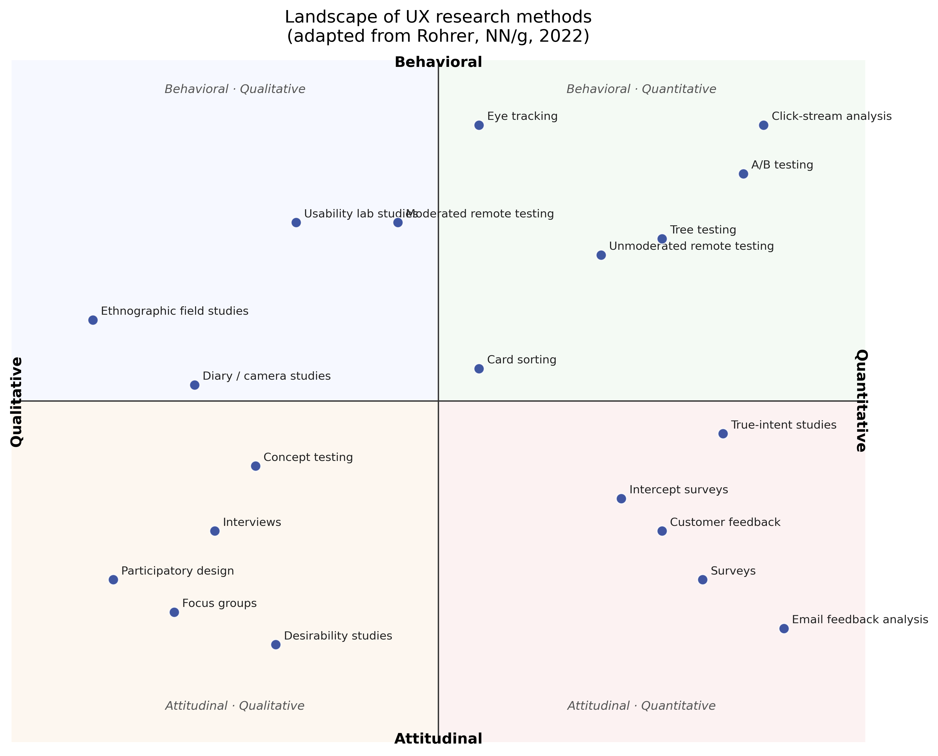
The methods landscape
Two binary axes: attitudinal-behavioural and qualitative-quantitative (after Rohrer NN/g 2022).
Quantitative: surveys, A/B testing, analytics, behavioural-metrics review.
• Qualitative: in-depth interviews, contextual inquiry, diary studies, usability testing.
• Frameworks: Double Diamond, Lean UX, Design Thinking - each forces a method choice per phase.
06 / 14

Slide 7
A seven-criterion fintech-fit rubric
CHAPTER 2 — A SEVEN-CRITERION FINTECH-FIT RUBRIC
Cost - time - evidence - bias - reg. fit - scalability - strategic value
07 / 14

Slide 8
Top tier of the fit rubric (1-5 scale)
Online surveys (incl. SUS)
Weighted total: 4.50
Heuristic evaluation
Weighted total: 4.40
Cognitive walkthrough
Weighted total: 4.40
Tree testing
Weighted total: 4.30
Top five methods - and the strategic addition of interviews
First-click testing
Weighted total: 4.30
Unmoderated usability
Weighted total: 4.20
08 / 14

Slide 9
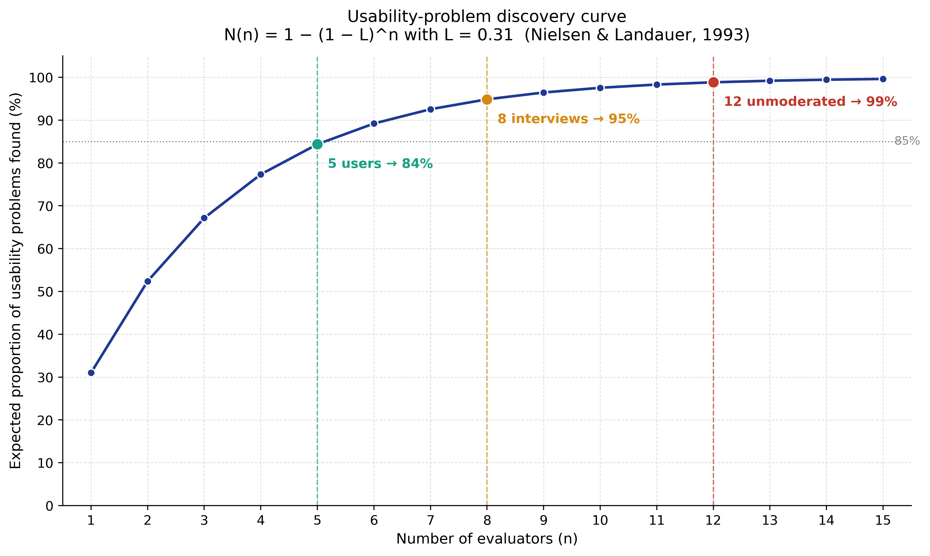
Sample-size logic
Nielsen-Landauer (1993) closed-form discovery model, L=0.31
n=5 covers ~85% of detectable problems per round.
• n=8 chosen for interviews - 94.9% per-round discovery.
• n=12 chosen for unmoderated test - 98.8% per-round discovery.
• n=220 chosen for SUS survey - +- 2.3 point CI on the mean (Sauro 2011).
09 / 14

Slide 10
NovaPay onboarding - what the four instruments saw
CHAPTER 3 — NOVAPAY ONBOARDING - WHAT THE FOUR INSTR
Simulated 1 000-user cohort + 12-respondent SUS + 8 interviews
10 / 14

Slide 11
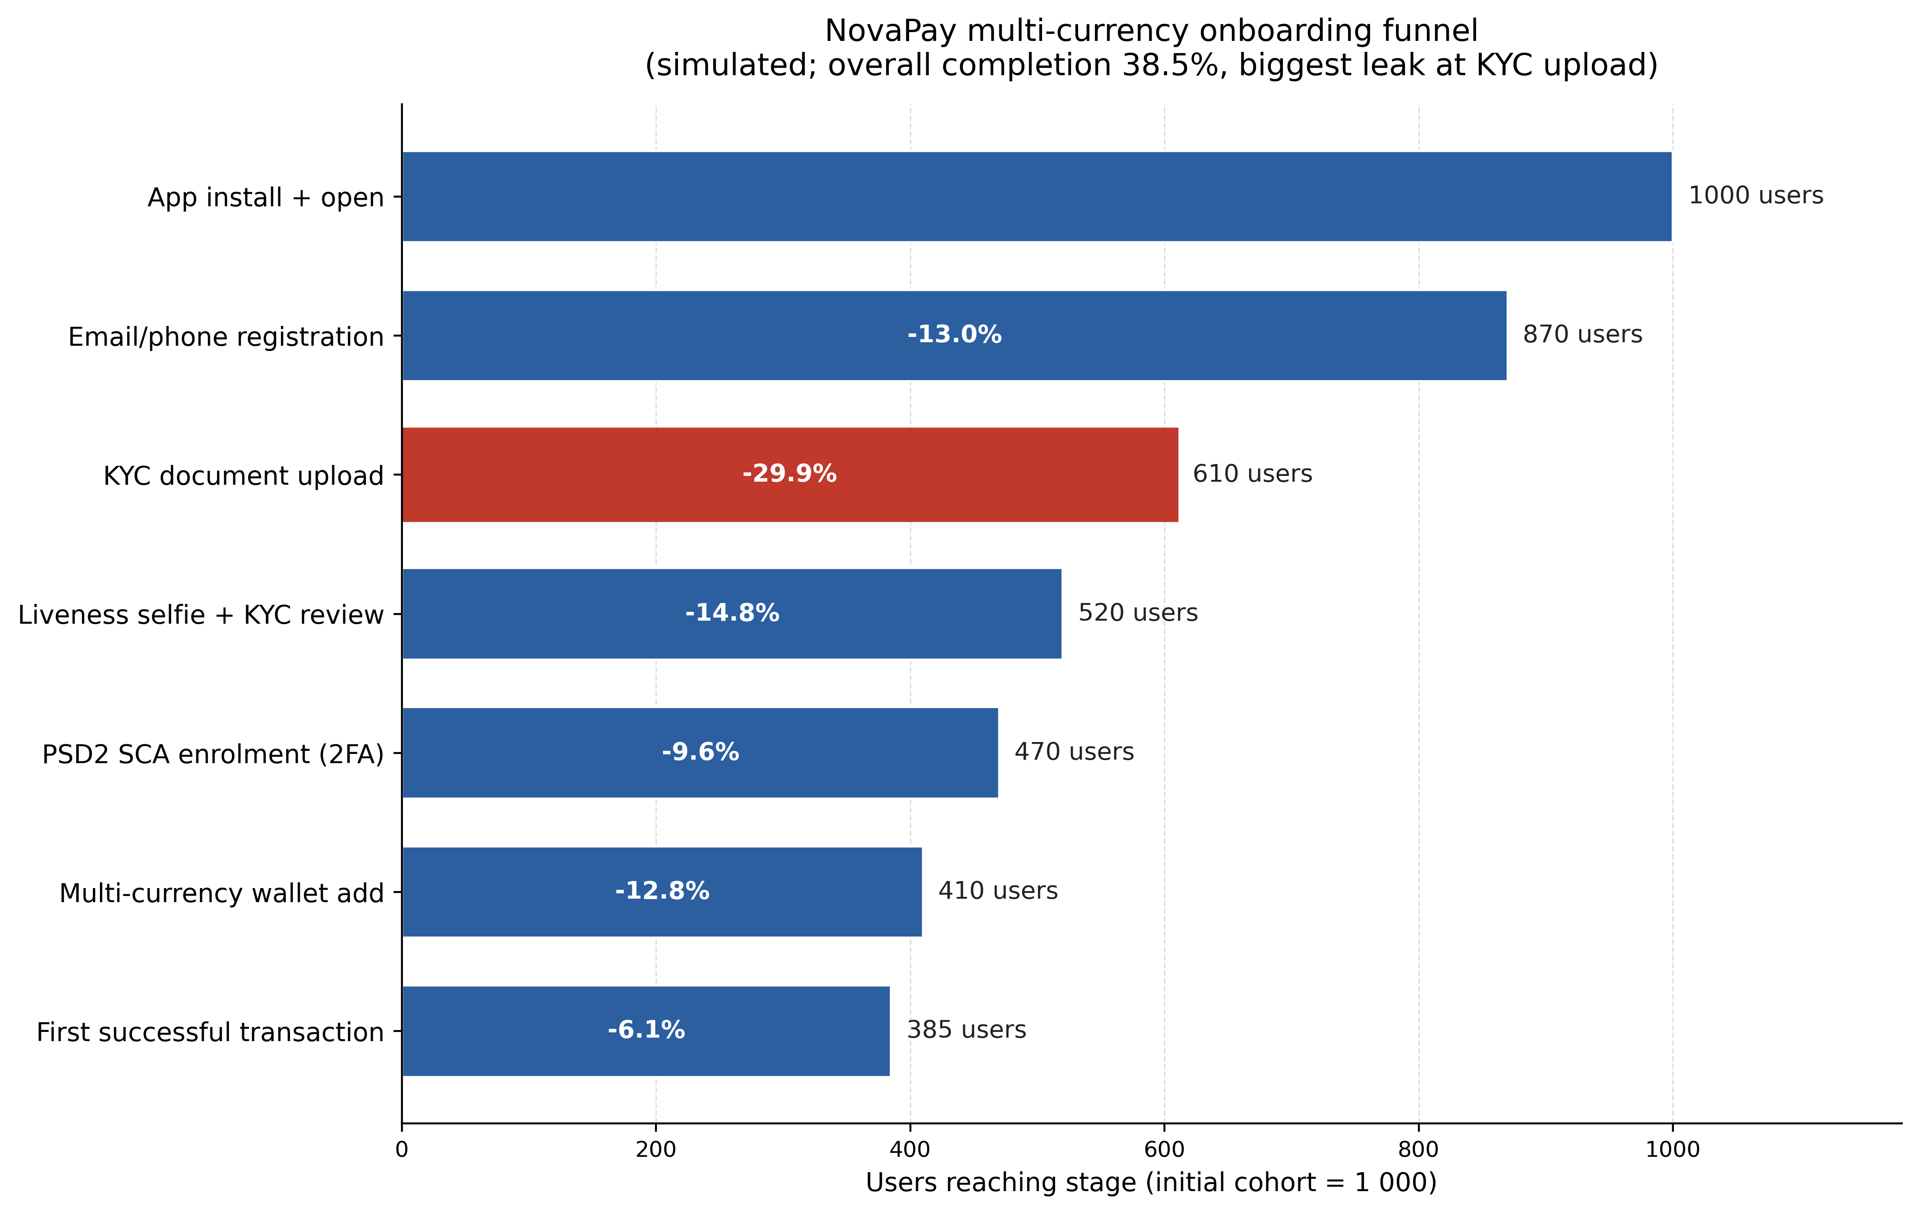
Onboarding funnel: where the leak is
38.5% cumulative completion vs Signicat European benchmark of 37%.
Largest single drop: 29.9 pp at KYC document upload.
• Liveness check is NOT the binding constraint (sub-10% drop).
• SUS mean = 71.7, 'Good' band, ~63rd percentile vs Sauro 2011 benchmark of 68.
• Two findings (screen-reader focus trap; FX-fee surprise) would have been missed by any single method.
11 / 14

Slide 12
Six high-leverage recommendations
Impact-effort matrix, cycle 1 commitments
01
Rewrite upload error copy
Name the specific reason and the next action - removes the most common KYC blocker.
02
Show KYC document examples
Pre-upload preview screens cut the 29.9 pp drop at the document step.
03
Client-side blur detection
Prompt a retake before submitting; reduces KYC rejection loop.
04
Default to biometric SCA
Surface SMS as a one-tap fallback; resolves the SCA confusion finding.
05
Move FX-fee preview
Show fee on the amount screen, not on the confirmation step.
06
Fix wallet-picker focus trap
VoiceOver + TalkBack regression test required - EAA compliance.
12 / 14

Slide 13
KPI plan for cycle 1
Measurable targets tied to the four-instrument triangulation
70.1% -> >= 85%
71.7 -> >= 76
KYC step completion
SUS score (embedded post-onboarding)
38.5% -> >= 45%
0.21 -> <= 0.15
First-transfer attempt within 7 days
Help-search to ticket ratio
13 / 14

Slide 14
University placeholder · 2026
Thank you for your attention
Ready for questions on rubric design, sample-size logic, and triangulation discipline.
Student name

